Slide 1


VEHICLE INSURANCE FRAUD DETECTION SOLUTION
Predictive Analytics Platform for INSURECO
Transforming Fraud Detection Through Data Intelligence

Slide 2


About InsureCo
AUTO
property
health
accident insurance

Slide 3




Vehicle Fraudulent Claims
Inflated Repair Bills
Challenges
Staged Accidents
Falsified Medical Reports
Falsified Repair Reports

Slide 4
Effect Of Vehicle Fraudulent Claims
Fraudulent Claims
Financial Loss
Higher Premium for honest customers
High Claim processing
Low customer Trust
10 to 15%
Fraudulent Payout

Slide 5

Collaboration
InsureCo
USD
Consultancy
Chief Risk Officer
Data Science Team
Finance Department
Claim Department (operator)
Fraud Investigation Unit
( End User)

Slide 6

Predictive Fraud Detection Partnership
Data-Driven Fraud Detection
A predictive model leverages data analytics to efficiently identify and prevent fraudulent claims in the insurance sector.
Real-Time Decision Support
Interpretability tools allow investigators to understand model predictions, enabling informed decisions quickly and accurately.
Enhanced Policyholder Trust
Transparent and fair processes reinforce trust among policyholders, ensuring confidence in claim evaluations.
Notes:
Image source: Microsoft 365 content library InsureCo partnered with USD Consulting to build a data-driven model for efficient fraud detection. The solution focuses on interpretability to help investigators make informed decisions in real time. This approach also aims to reinforce policyholder trust by ensuring transparency and fairness throughout the process.

Slide 7
The Problem we are solving..

Slide 8
Error Type | Model Term | Example | Business Cost | Why It Matters
Missed Fraud | False Negative (FN) | Fraud goes undetected | Large ($60,000 per case) | Direct financial loss
False Alarm | False Positive (FP) | Legitimate case flagged as fraud | Smaller (approx. $500-1000 per case) | Wastes resources, hurts customer experience
What is the estimated financial loss for a False Negative (missing a fraudulent claim) versus the cost of a False Positive (investigating a valid claim)?

Slide 9
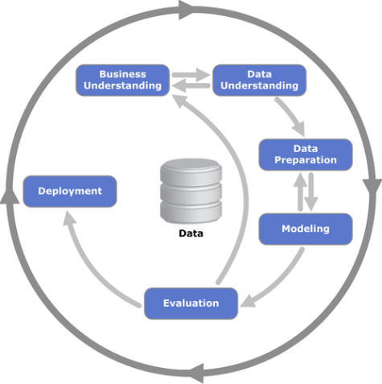
How are we approaching it…..
Cross-industry standard process for data mining (CRISP-DM)
Reference: https://en.wikipedia.org/

Slide 10
About Data…
Customer Information: age, gender, occupation, education.
Policy Details: policy number, premium, coverage type, and policy age.
Incident Data: incident type, collision severity, and police report availability.
Financials: claim amount, deductible, and umbrella limit

Slide 11

Issues with data and how we resolved..
Missing values
Outliers
Uneven distribution/Class imbalance
Non Fraud vs Fraud=75:25

Slide 12
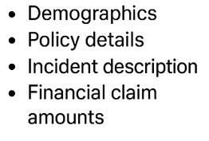
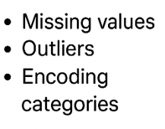
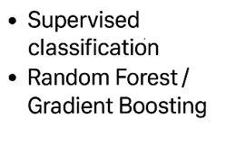
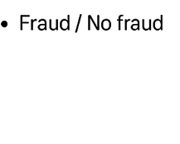
Model Development Workflow
Data
Data
Pre Processing
Machine Learning Model
Fraud Prediction

Slide 13
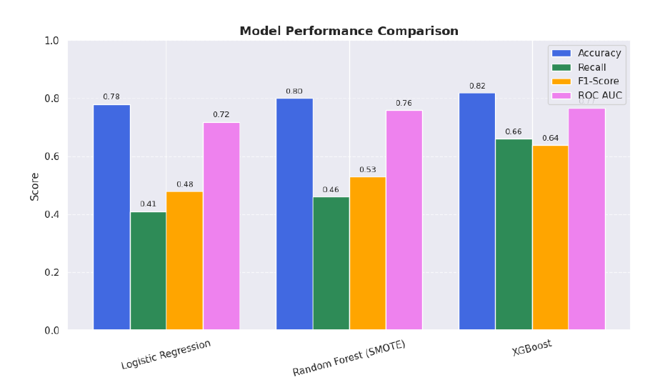
Model selection Strategy
Evaluation Metrics
ROC-AUC ≥ 0.80-distinguishing fraudulent vs. legitimate claims
Precision ≥ 60%-to ensure investigative efficiency and minimize false
Recall> 50 %- to catch the majority of fraudulent claims
Demonstrate financial benefit by reducing undetected fraud by 10–15%.

Slide 14

The goal is to
Identify key fraud predictors
Optimize precision-recall balance
Minimize false alarms.

Slide 15
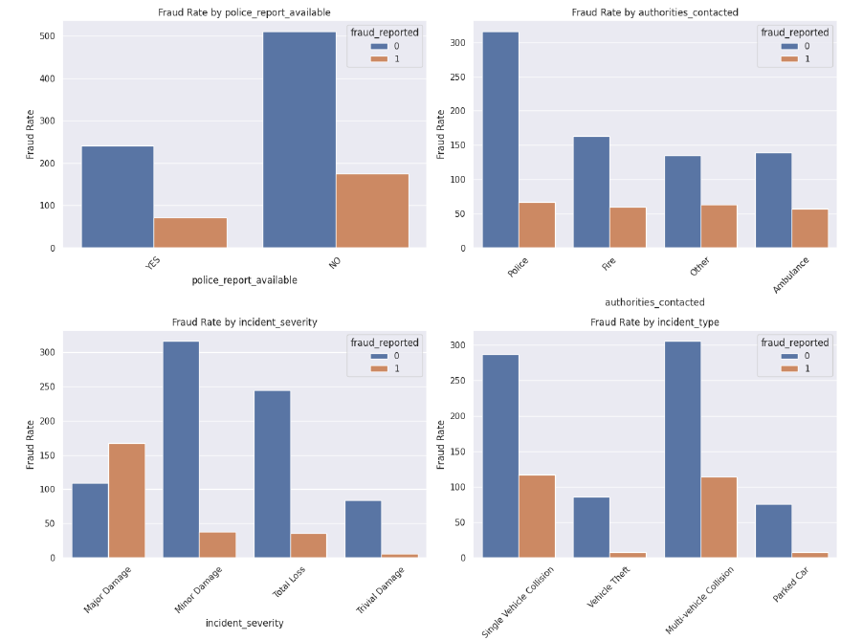

Insights We Uncoverd..
What is the fraud rate by reporting behavior?
Fraud rates higher in claims without police reports, major damage, and multi-vehicle collisions

Slide 16
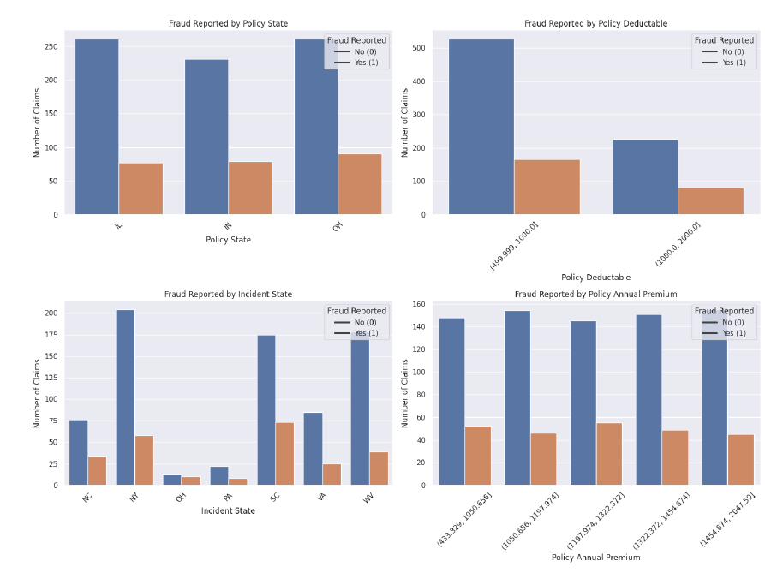
Fraud patterns across policy features and Claims attributes?
More Fraud in High-Premium Policies and Low Deductibles

Slide 17
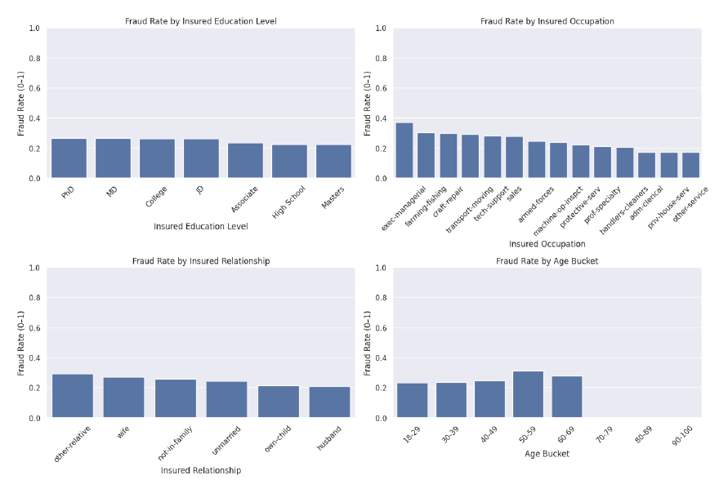
Customer Attributes vs fraud?
Managers, repair workers, people aged from 50–59, and non-family claimants are more likely to commit fraud.

Slide 18
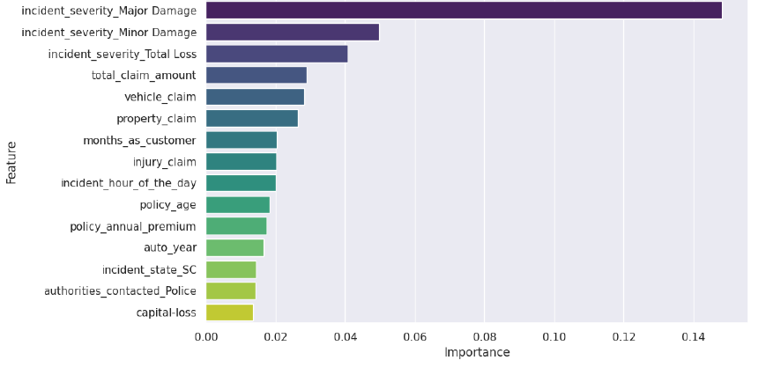
Feature Importance Analysis
Key predictors like collision type and claim amount are top features that differentiate fraud from genuine claims.

Slide 19
Expected Business Impact
OPERATIONAL IMPACT
FINANCIAL IMPACT
STRATERGIC IMPACT

Slide 20
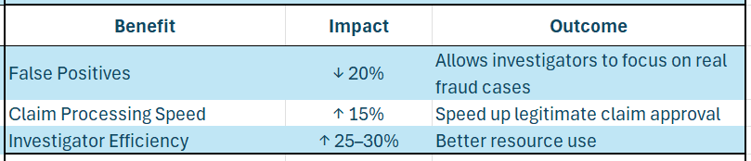
OPERATIONAL IMPACT ON BUSINESS

Slide 21
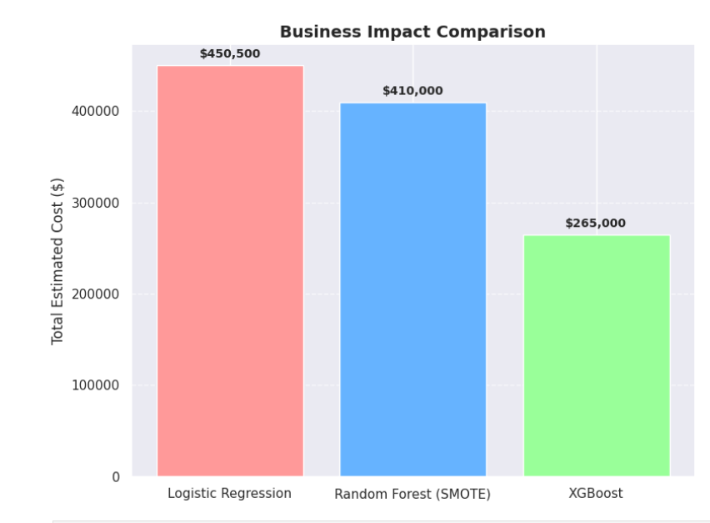
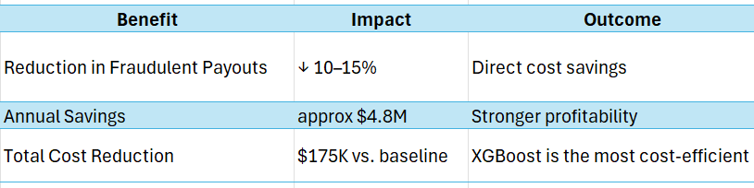
Financial Business Impact

Slide 22
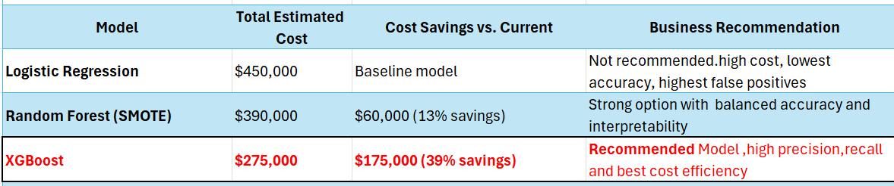
Model Cost Comparision

Slide 23
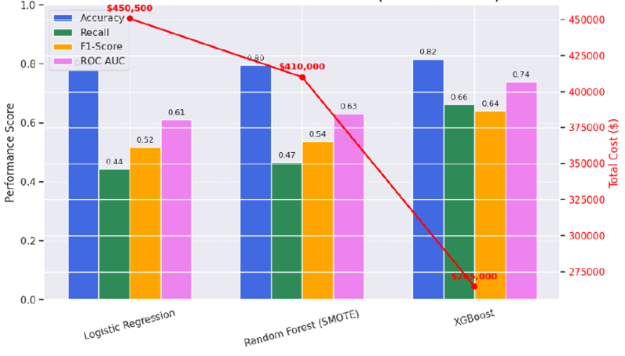
MODEL PERFORMANCE AND COST COMPARISION

Slide 24

Strategic Business Impact:
Customer trust and retention
Competitive advantage and leadership positioning
Data-driven insights to make smarter decisions about insurance pricing and risk control

Slide 25
Solution Deployment Plan
Where
How
Monitor
Outcome

Slide 26


How
Monitor
Outcome
Where
Integrated with the claims management

Slide 27

Where
How
Monitor
Outcome
Integrated with the claims management
Display Risk Score
Feature Explanation
Recommends Next Step

Slide 28

Where
How
Monitor
Outcome
Integrated with the claims management
Display Risk Score
Reports
Feature Explanation
Tracking Performance
Recommends Next Step
Continuous Retraining

Slide 29

Where
How
Monitor
Outcome
Integrated with the claims management
Display Risk Score
Reports
Real Time Fraud Detection
Feature Explanation
Tracking Performance
Faster Investigation
Recommends Next Step
Continuous Retraining
Explainable Results

Slide 30
Solution Deployment Plan
Where
How
Monitor
Outcome
Integrated with the claims management
Display Risk Score
Reports
Real Time Fraud Detection
Feature Explanation
Tracking Performance
Faster Investigation
Recommends Next Step
Continuous Retraining
Explainable Results

Slide 31
Next Steps
integration timeline
Finalize feature engineering and model validation.
Deploy pilot fraud detection model within claims system.
Monitor KPIs (fraud reduction %, processing time, false positives.
Train staff and monitor key performance metrics such as fraud reduction percentage and false positive rate.
Continuous model improvement using new claim data.

Slide 32
Contact
Sheshma Jaganathan

Slide 33
THANK YOU!!

